Slide 1
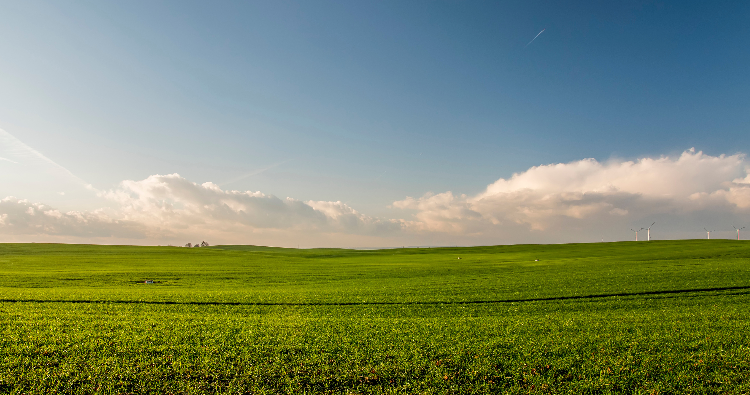
01
Agriculture Plot Analysis
Done By:
Sundar R - S20220010215
Kache Nivas - S20220010092

Slide 2

02
GIS-Based Agricultural Decision Support
Rapid urbanization and climate change are affecting agricultural productivity.
Farmers need decision-making tools for selecting optimal plots and infrastructure planning.
GIS offers spatial insights through multi-layered analysis.
This project focuses on helping farmers in Yelahanka(North Bengaluru) and Sarjapur(South Bengaluru) identify the best land for thier specific needs.

Slide 3
03
Problem Statement & Goals
Problem:
Farmers lack spatial tools to evaluate plot suitability and other parameters for decision making.
Objectives:
Identify suitable plots for cultivation based on environmental and soil conditions.
Determine shortest access routes from plots to other amenities using road network analysis.
Develop a methodology that is replicable and scalable for various other crops and parameters

Slide 4
04
Study Area: Yelahanka and Sarjapur
Yelahanka:
A rapidly developing peri-urban region in North Bangalore, known for a mix of residential zones, agricultural activity, and expanding infrastructure.
Sarjapur:
A peri-urban region with diverse terrain, road networks, and active agriculture.
Datasets Used:
Satellite Imagery
Temperature, Elevation, Slope, Air Quality(raster)
Land Plots, Forest, Waste Dumping Land, Water Bodies, Residential Complex(polygon)
Market Access, Farmer Education center, AgroHub Industries, Co-op Banks, Hospitals(point)
Roads (line)

Slide 5
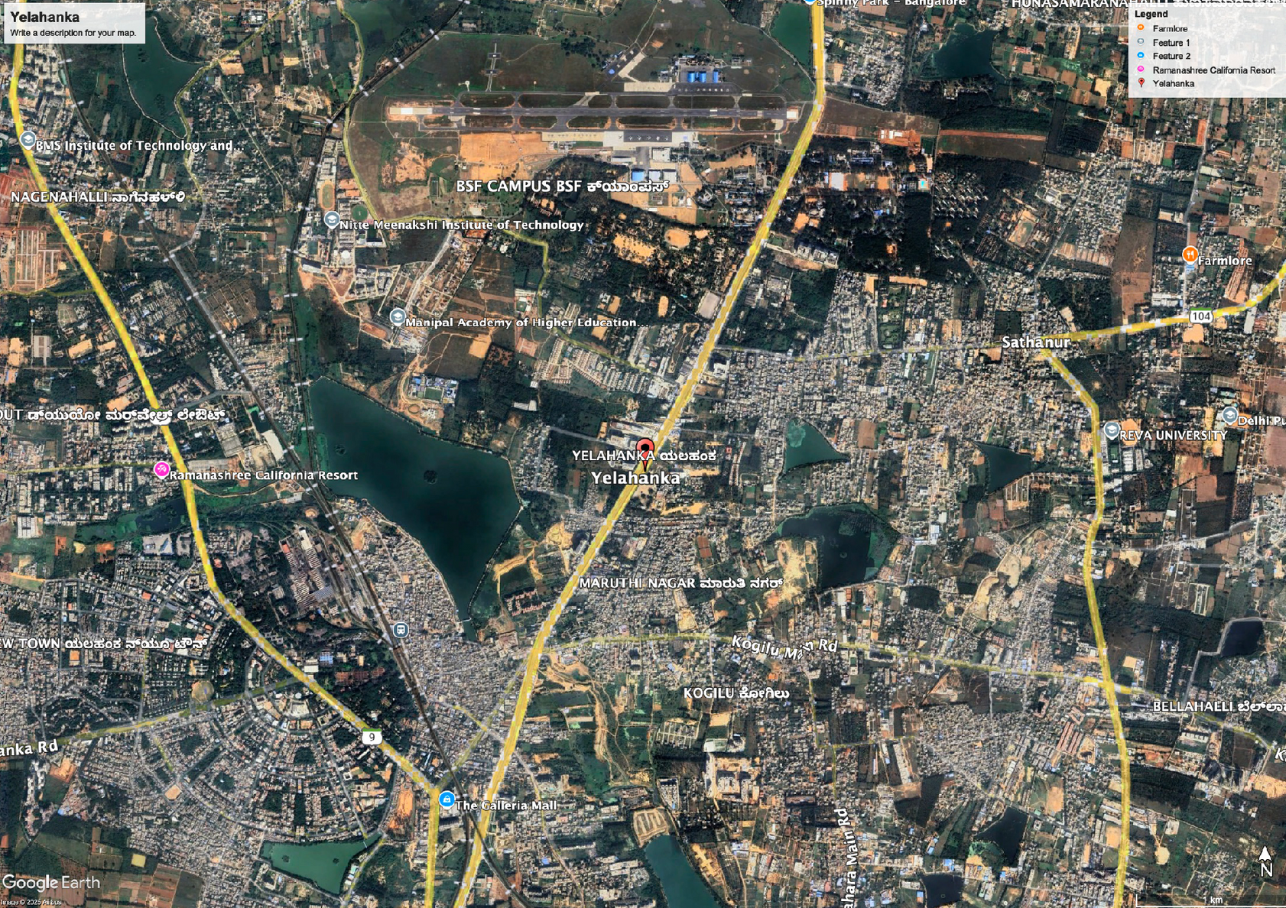
05
YELAHANKA(NORTH BENGALURU)

Slide 6
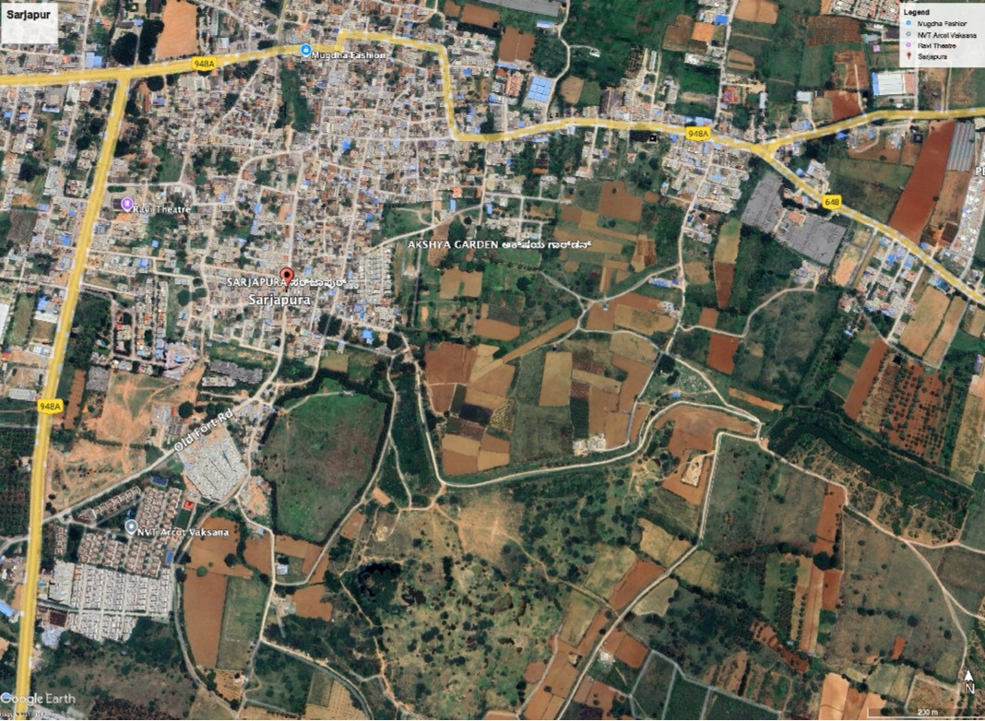
06
SARJAPUR(SOUTH BENGALURU)

Slide 7
07
Workflow Diagram
Data Collection & Preprocessing
Result Visualization & Map Output
Vector-Based Filtering
Proximity & Accessibility Analysis
Raster Preparation & Normalization
Vector and Raster Analysis

Slide 8
08
Data Acquisition & Preparation
Data Sources: Vector layers were digitized using satellite imagery from Bhuvan manually
Attribute Enhancement: Soil Type was manually added to attribute Table.
Layers Used & Purpose:
Agro Hub Industry (point): Agricultural processing and support
Residential Complex (polygon): Avoid urban-agriculture conflict
Hospitals (point): Emergency access planning
Forest (polygon): Avoid restricted/sensitive zones
How are Vector Layers Obtained?

Slide 9
09
Data Acquisition & Preparation
Layers Used & Purpose:
Water Bodies (polygon): Assess irrigation potential
Market (point): Access to agri-supply chains
Waste Dumping Land (polygon): Excluded from analysis
Land Parcels (polygon): Base layer for suitability checks
Cooperative Banks (point): Access to financial services
Roads (line): Connectivity and routing
Farming Education Centers (point): Farmer knowledge access

Slide 10
10
Data Acquisition & Preparation
How Raster Layers are Obtained?
Data Sources:
Raster layers sourced from remote sensing platforms like SRTM via Google Earth Engine.
Preprocessing:
Reprojected to common CRS
Clipped to study area
Standardized pixel resolution
Layers & Purpose:
NO₂ (Air Quality): Assess pollution impact on crops
Elevation: Terrain analysis, slope derivation
Slope: Water retention, machinery access
Temperature: Crop growth & heat stress zones

Slide 11
11
Queries & Logic: Yelahanka
Query 1(Vector): Identify areas suitable for establishing a new agro-processing industry, ensuring they are close to key facilities but far from environmentally sensitive zones
Method:
Buffer Creation:
Create a 2 km buffer around roads and agro-industries.
Create a negative buffer (500 m) around water bodies, forests, and residential areas to exclude them.
Overlay Analysis:
Intersect the positive buffers with the land layer to find potential areas.
Erase regions overlapping with negative buffers.
Final Selection:
The resulting polygons indicate the most suitable locations for setting up new facilities.

Slide 12
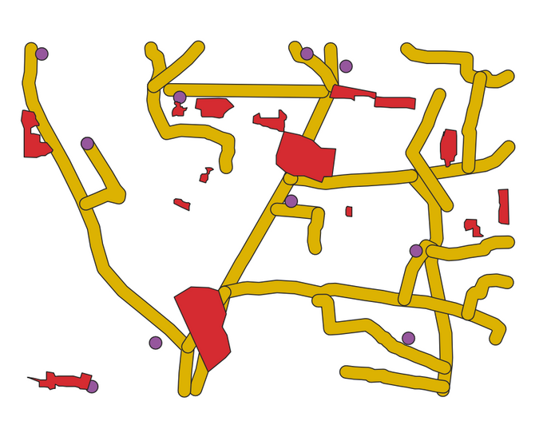
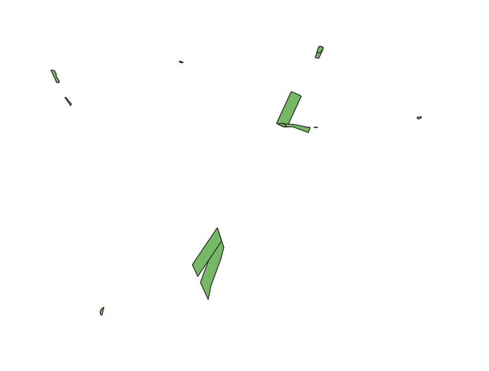
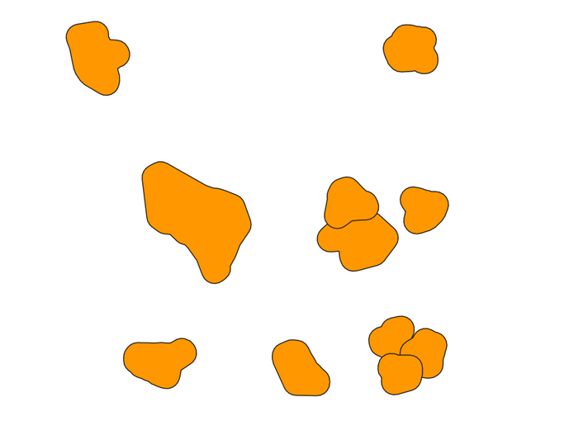
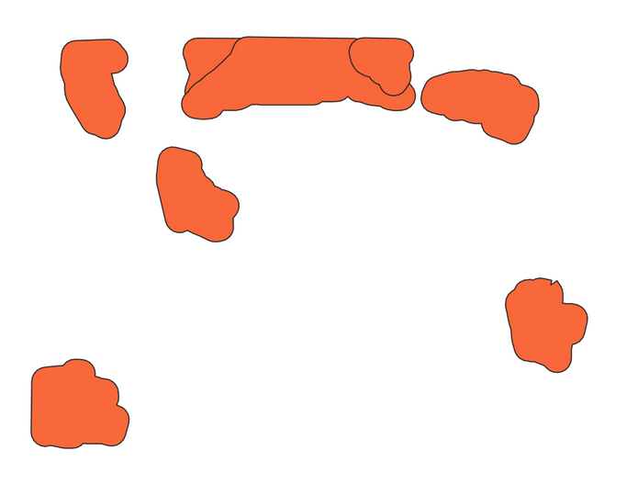
12
Intersection of Buffered Roads and Agro-Industries with Land
Positive Buffer
Forest Buffer
Water Buffer

Slide 13
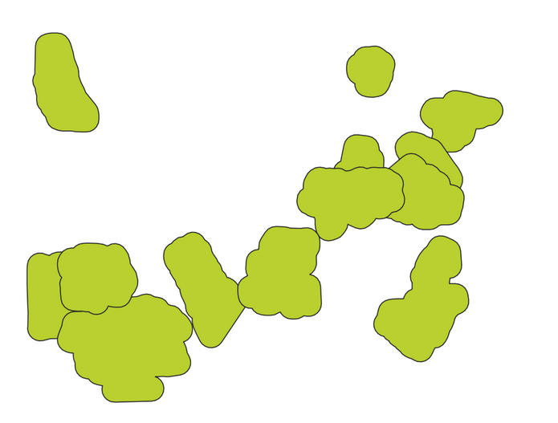
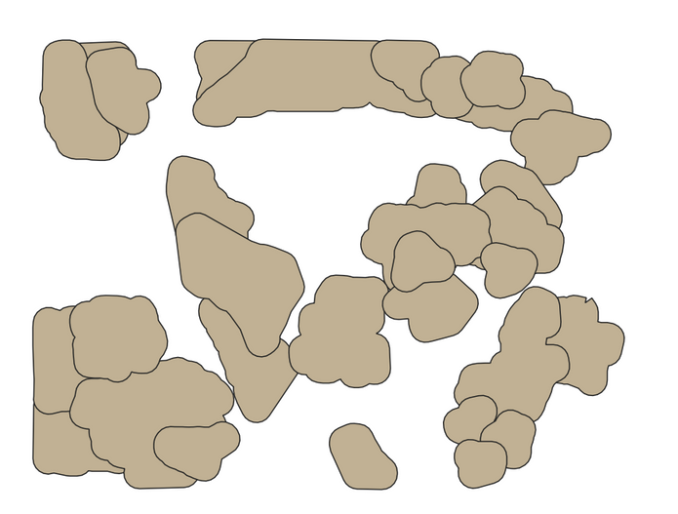
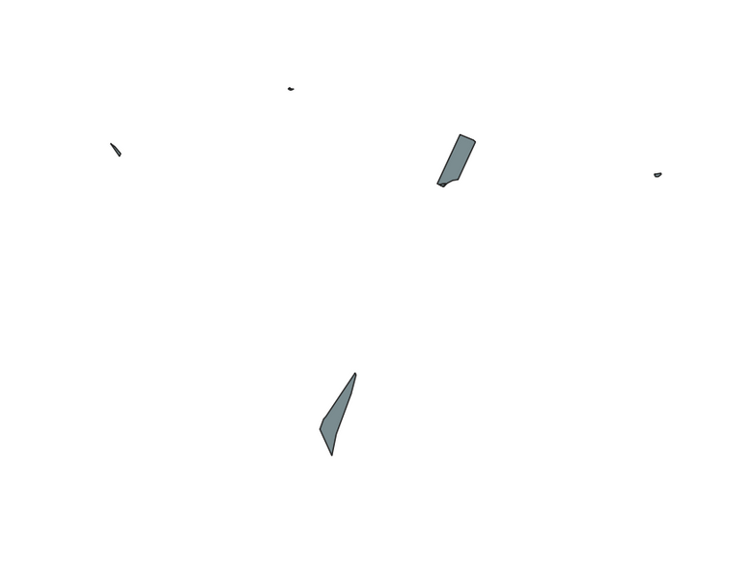
13
Buffer Residential
Negative Buffer
Result

Slide 14
14
Queries & Logic: Yelahanka
Query 2 (Vector):
Determine the fastest route from a market to an agro-processing industry.
Method:
Network Preparation:
Ensure the road network has a travel_time field (in minutes), calculated using length and assigned speed.
Shortest Path Analysis:
Use the Shortest Path (Point to Point) tool in QGIS:
Start Point: Market location
End Point: Agro-Industry location
Cost Field: travel_time
Result:
The output line shows the fastest travel route along the road network, based on the travel time field.

Slide 15
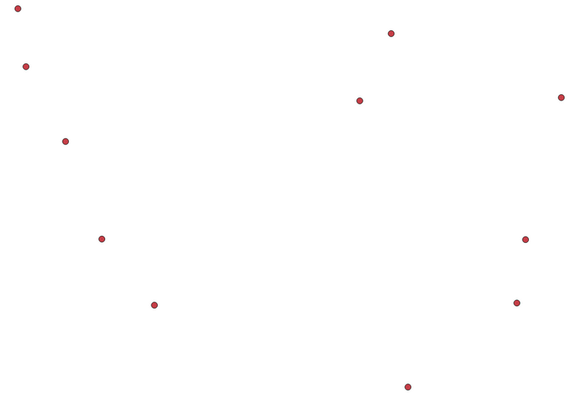
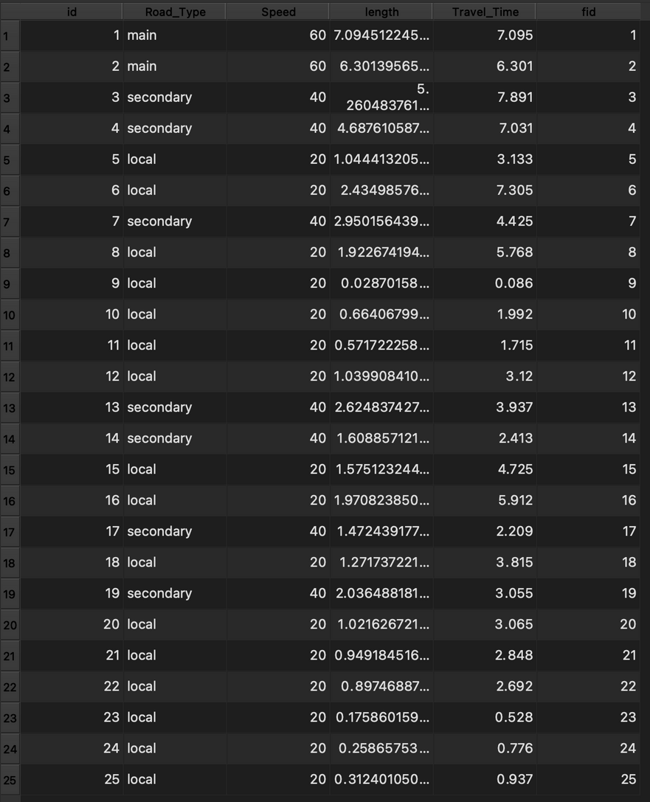
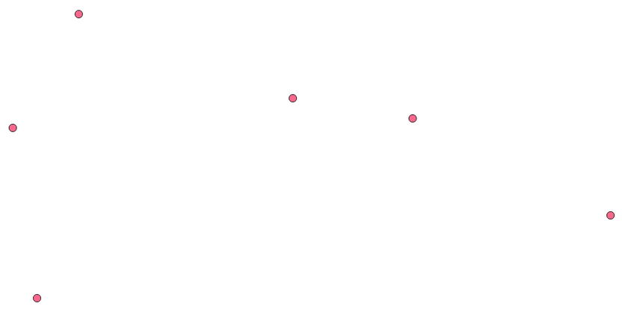
15
Market
Attribute Table
Co-op Bank

Slide 16
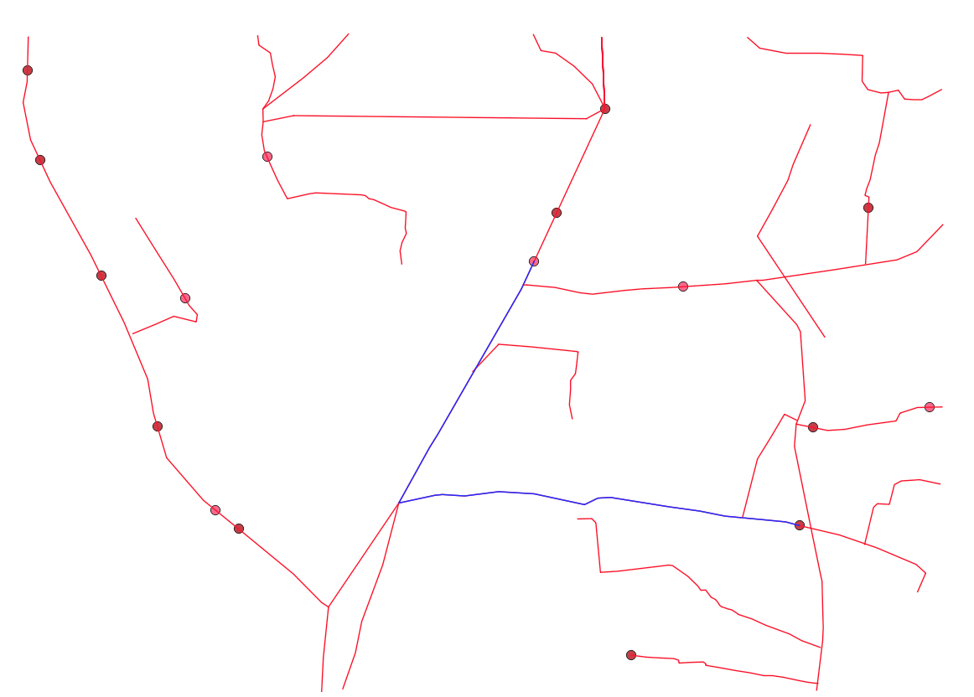
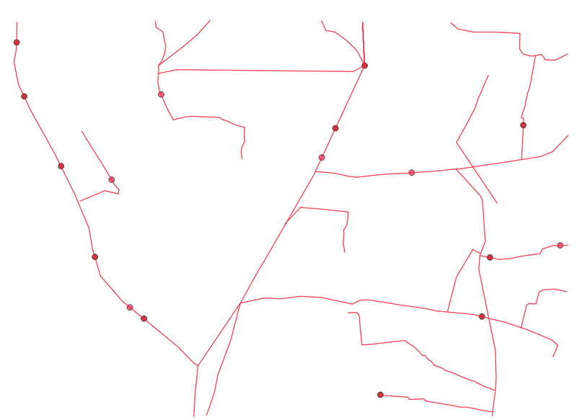
16
Roads with constraints
Result

Slide 17
17
Queries & Logic: Yelahanka
Query 3 (Raster + Vector):
Identify zones suitable for prolonged agriculture with low NO₂ levels and favorable cool temperatures.
Method:
Reclassify Rasters:
NO₂: Low = 1 (suitable), Medium–High = 0
Temperature: Cool–Moderate = 1, High = 0
Overlay using Raster Calculator:
Reclass_NO2 * Reclass_Temp
Output 1 indicates optimal conditions(0.6*No2 + 0.4*Temp).
Mask with Land Vector Layer:
Use “Clip Raster by Mask Layer” to retain only land areas.
Result:
Final output shows land parcels ideal for long-term agriculture under clean air and favorable temperature zones.

Slide 18
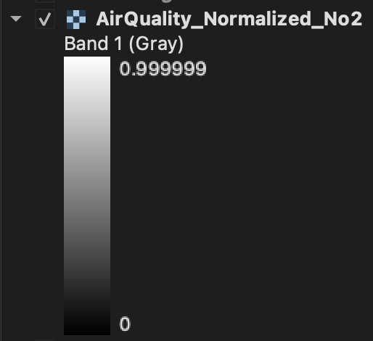

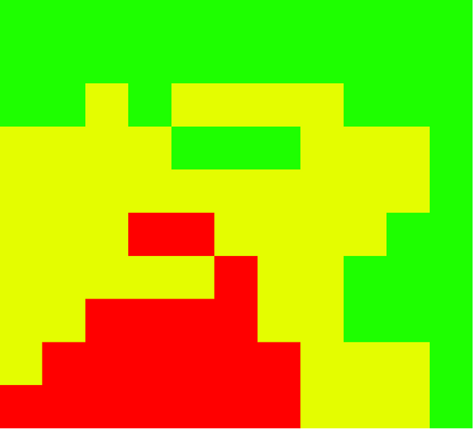
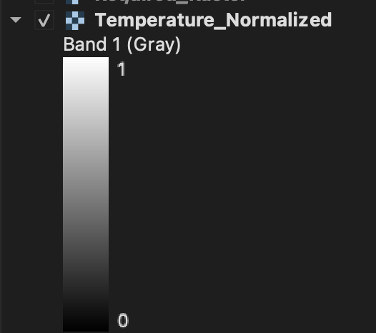
18
AirQuality-Normalized
Air Quality No2
Temperature
Temperature-Normalized

Slide 19

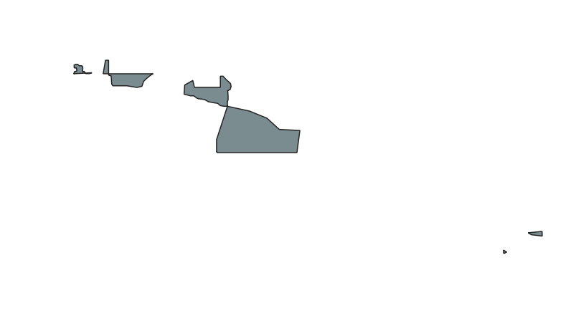
19
Required - Raster with Land
Output Layer

Slide 20
20
Queries & Logic: Sarjapur
Query 1 (Raster + Vector):
Identify optimal plots for cotton cultivation using soil and environmental factors.
Method:
Filter by Soil Type:
Select and export plots with black soil from the land parcel layer.
Raster Overlay:
Use Slope, Elevation, and Temperature rasters.
Normalize each raster to a 0–1 scale.
Calculate Suitability (Raster Calculator):
Cotton Suitability = (0.3 × Slope_norm) + (0.2 × Elevation_norm) + (0.5 × Temp_norm)
Final Masking:
Clip the Suitability Raster using the black soil vector layer.
Result:
Output highlights suitable zones for cotton within black soil regions based on environmental parameters.

Slide 21
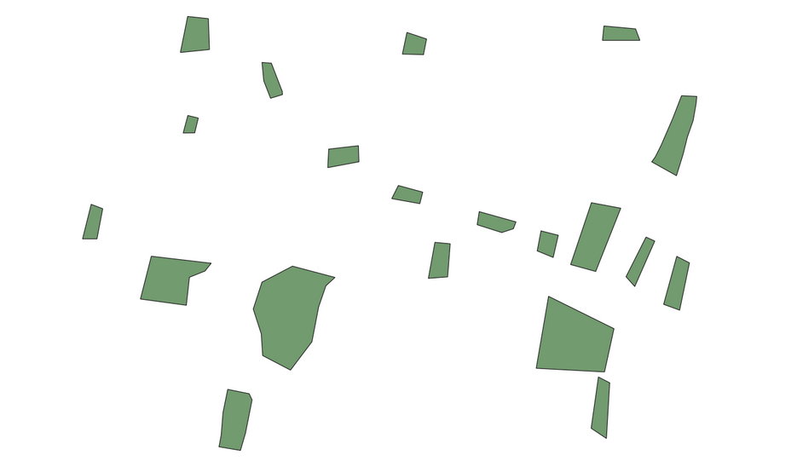
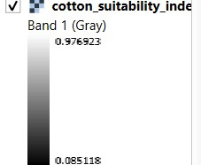
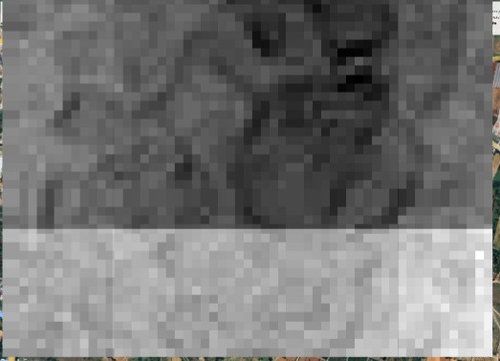
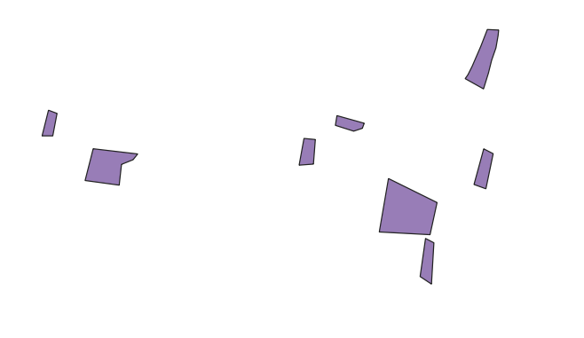
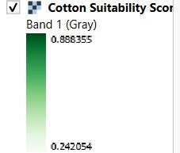
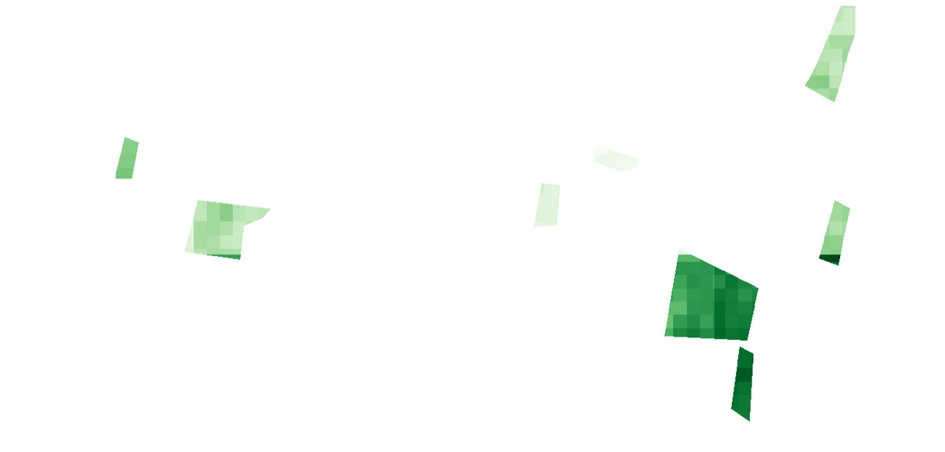
21
Cotton_Suitability_
Index
All available Land Plots
Plots with only Black Soil
Final output with the suitability index overlayed over black soil land plots

Slide 22
22
Queries & Logic: Sarjapur
Query 2 (Vector):
Find ideal locations for farmer housing based on proximity to amenities and avoidance of unsuitable areas.
Method:
Buffer 200m around:
Negative features: Residential areas, dumps, water bodies → Union → Negative Zone
Positive features: Roads, hospitals, land plots, markets → Union → Positive Zone
Final Output:
Suitable Area = Positive Zone - Negative Zone
Result:
Optimally located housing zones with access to amenities and minimal risks.

Slide 23
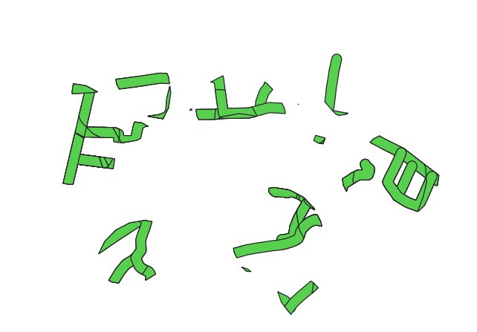
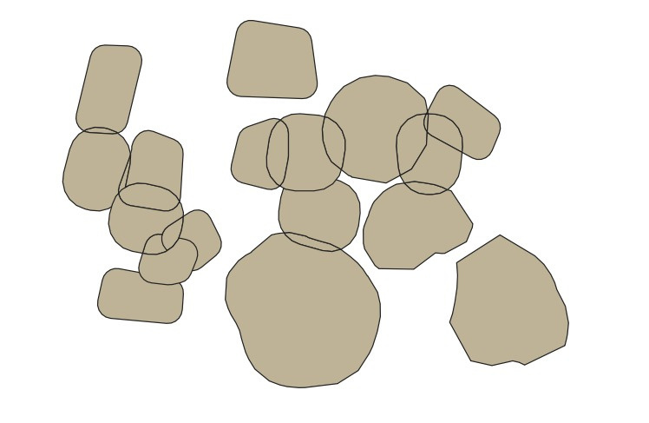
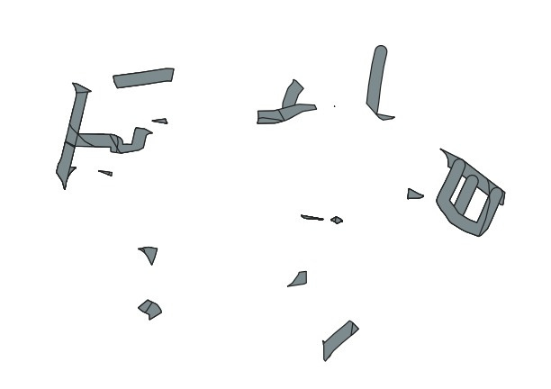
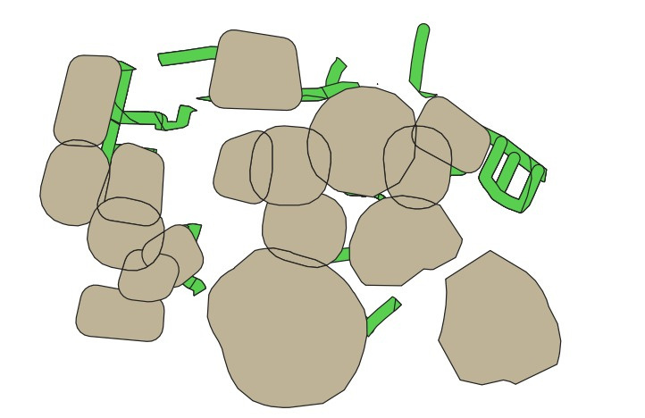
23
Positive Buffer
Negative Buffer
Both Layers Overlayed
After difference

Slide 24
24
Queries & Logic: Sarjapur
Query 3 (Vector):
Identify land plots with best road access for efficient produce transportation.
Method:
Buffer 200m around:
Road network → Road_Buffer
Select by location:
From Land_Plots that intersect Road_Buffer → Selected_Plots
Final Output:
Selected_Plots within 200m of roads
Result:
Land plots with optimal transport connectivity for agricultural produce.

Slide 25
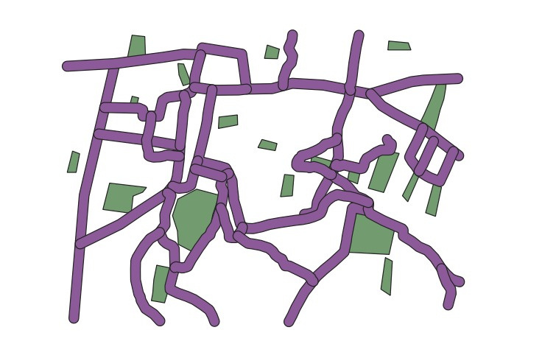
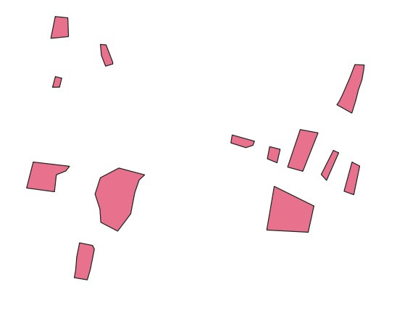
25
Road Buffer and Plots Layer
Result

Slide 26
26
Queries & Logic: Sarjapur
Query 4(Vector):
Identify the shortest paths from all land plots to every market.
Method:
Reduce the polygon plot layer to it’s centroid point layer for network analysis:
Land_Plot(Polygon) → Land_Plot_Centroids(Point)
Network Analysis:
Found the shortest path to each market from individual centroid points, Using Shortest Path(point to layer) network analysis tool.
Final Output:
Merge all the obtained intermediate vector layer for each source point.
Result:
A vector layer with the shortest paths laid out from each land point to every market point.

Slide 27
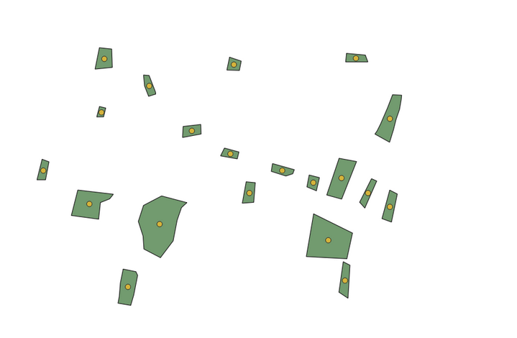
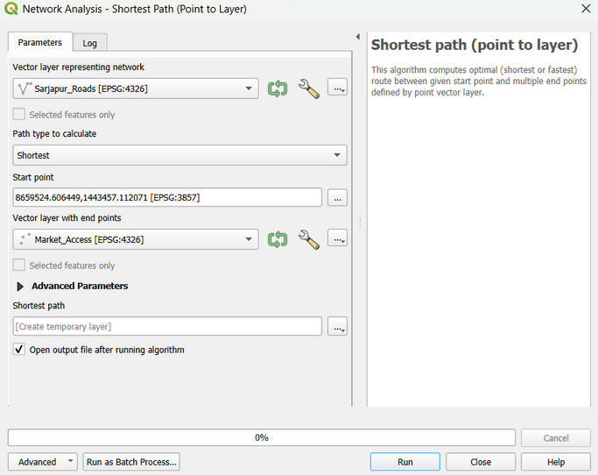
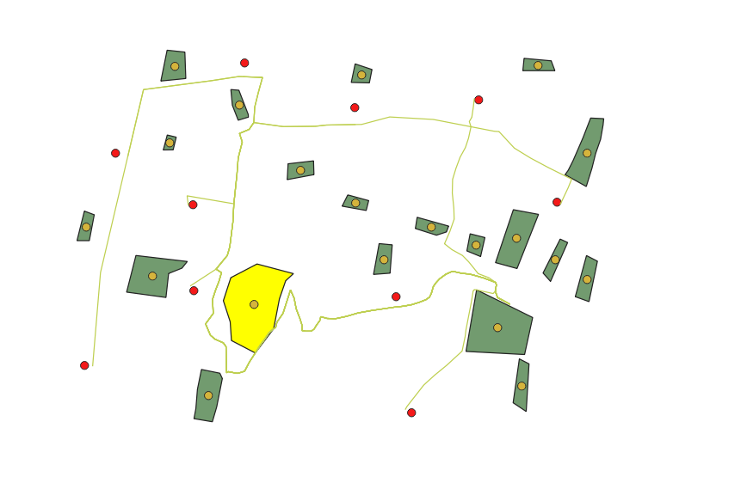
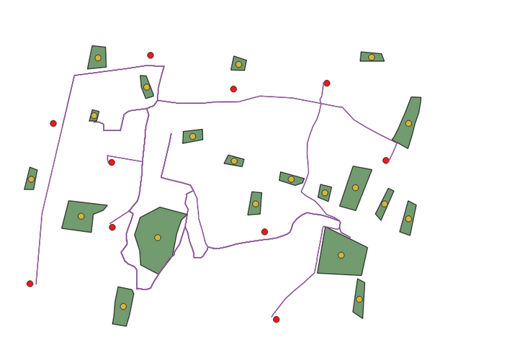
27
Land Plots and it’s centroids
Performing Network analysis on each point individually
Intermediate layer from one source plot point
Merged Final Layer

Slide 28
28
Market Research
Market Research
Target Users
Smallholder farmers (rural & semi-urban India)
Agricultural officers & planners
NGOs in rural development
Agri-tech startups & researchers
Key Problems Identified
No easy tools for identifying suitable agri-land
Difficulty accessing info on proximity to markets, hospitals, water
Data is fragmented and outdated
Lack of digital support for crop planning

Slide 29
29
Market Research
Tool | Features | Limitations
AgriStack | Govt. agri-database | Limited Access, still evolving
Bhuvan Geoportal | Land use satellite maps | Lacks crop-specific/local detail
farmonaut | Crop health via remote sensing | Doesn’t suggest land/crop suitability
Google Earth Engine | Advanced spatial tools | Requires Programming Know-How

Slide 30
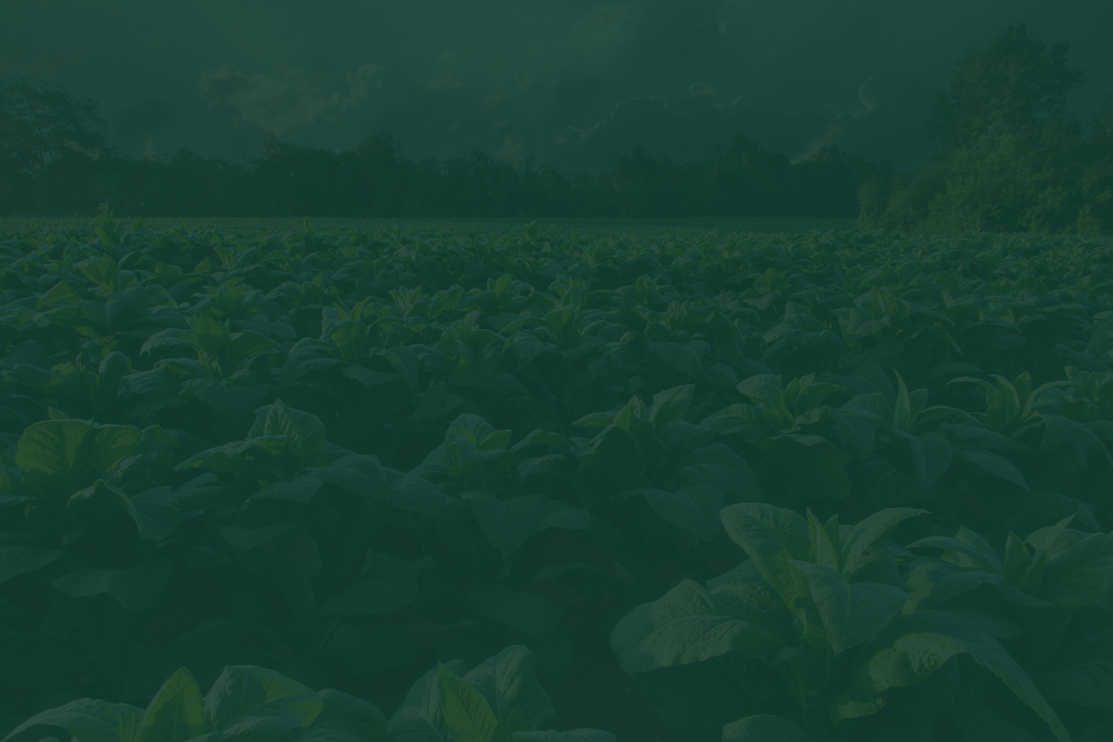
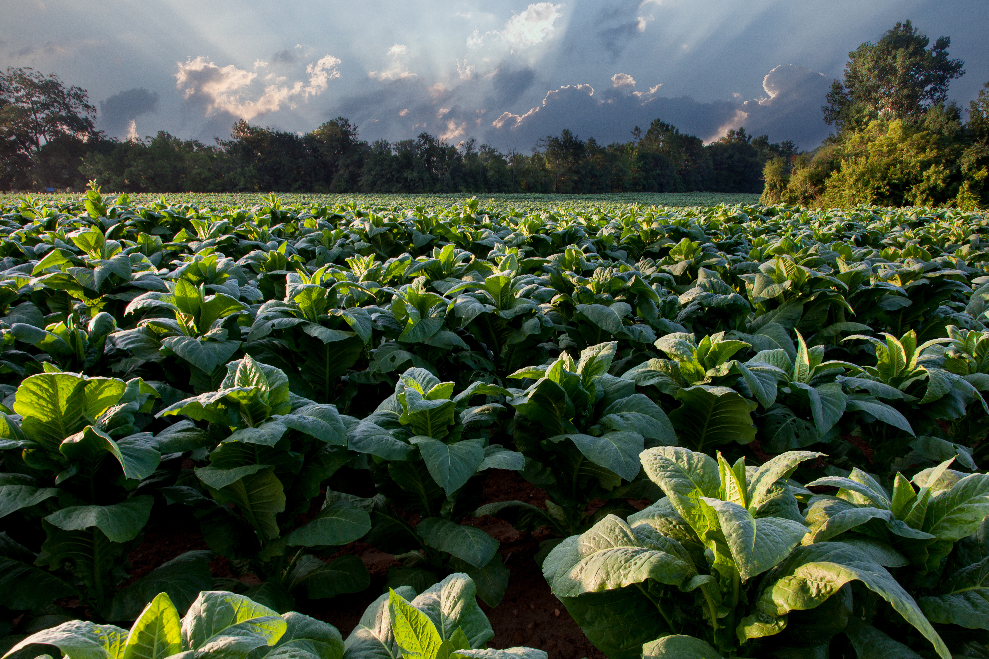
30
Thank You!

